Slide 1
Agricultural Commodity Prices in Maharashtra using Time Series Analysis

Slide 2
Aim
To analyze trends and seasonality of commodity prices for different Agricultural Produce Market Committee (APMC) in Maharashtra, India
To identify price fluctuations for different commodities
To depict insights visually by using Python.

Slide 3
Methodology
The methodology is divided into four parts :
1.Data Exploration Phase
2.Data Transformation
3.Price Comparison
4.Flagging Data

Slide 4
Data Exploration Phase
Outliers were analyzed in category of Kharif Crops , Rabi Crops and other crops on the basis of MSP*.
Any data point which is below Q₁ – 1.5× IQR* or above Q₃ + 1.5× IQR is considered as an outlier, where IQR = Q₃ – Q₁ .
Similarly, outliers in monthly dataset, for modal price is also calculated on the basis of each APMC*** and commodity.
*MSP stands for Minimum Support Price.
**IQR stands for Inter Quartile Range.
*** APMC stands for Agricultural Produce Market Committee.

Slide 5
Data Transformation
Judging Seasonality :
Additive Seasonality* : is de-seasonalised by subtracting each value from its corresponding seasonal index.
Multiplicative Seasonality** : is done by dividing each value from its corresponding seasonal index.
Calculating Seasonal Index : Seasonal Indexes are calculated using Centered Moving Average method by taking an average of first 12 months , then next 12 months and so on.
Calculations :
Ratio :is calculated by dividing actual price by its Centered Moving Average.
Unadjusted factor : is calculated by taking average of ratio of all years for similar months.
Adjusted factor : is calculated by multiplying it by number of months and by dividing it by the sum of corresponding unadjusted factor of each year to get a seasonal index.
Deseasonalized Price : is calculated by dividing actual price by its adjusted factor.
Notes:
Additive Seasonality* : Models with additive Seasonality assumes that the difference between any 2 months say January and July is approximately same each year which implies that amplitude of the seasonal effect is same each year.
Multiplicative Seasonality** : Models with Multiplicative Seasonality rather than focusing on constant difference, focuses more on proportional change.

Slide 6
Price Comparison and Flagging Data
Comparing Actual Price (which is Modal Price) with its MSP Price and Deseasonalized Price
Variation Coefficient is calculated using ratio of standard deviation to its Mean. Commodities with High Variation Coefficient represents highest fluctuation in its prices.

Slide 7
Why This Approach ?
Identification of outliers : is important as presence of outliers indicates biased data .The reason for biases in data could be such as data may have been coded incorrectly or experiment may not have been performed correctly.
Deseasonalizing Prices : is important for decoding the underlying trends in the data, which were masked due to seasonality factor. It balances out the short term fluctuations and identifies the long term trend.

Slide 8
Assumptions
Replaced Nan values in commodity’s modal price with average price of that commodity so that empty values do not interfere with data processing.
Variation coefficient above 3 standard deviation from its mean values which is 99 percentile is considered as a bar value. Any value exceeding this limit value is considered in the highest price fluctuation category.

Slide 9
Shortcomings
Statistical outlier detection methods served certain problems:
Cannot be applied in case of multi dimensional space.
Limited to large Real world databases because no prior knowledge is available regarding the distribution of dataset
Centered Moving Average method has certain limitations :
Not Applicable in case of short time series.
Does not take into Account the data outside the average period.

Slide 10
Problems Faced
Year 2012 and 2013 have no corresponding modal price for it.
Removed Clusters whose count is less than 12
Insufficient MSP data for certain commodities.

Slide 11
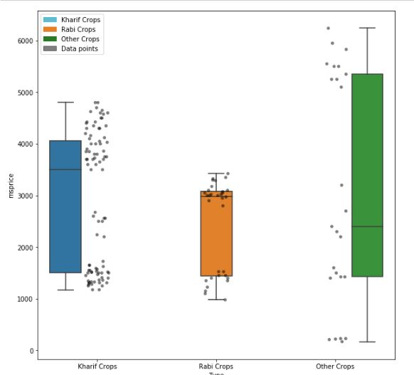
Insights
There are no outliers in case of Kharif, Rabi and other crops category. All the data points lie within the normal range(Q₁ – 1.5× IQR*, Q₃ + 1.5× IQR).
Notes:
Outliers are in Kharif Crops and Rabi Crops
No outlier is detected in other crops category

Slide 12
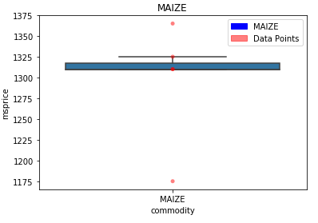
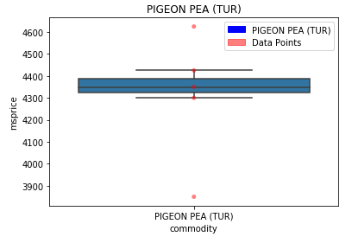
Kharif Crops
Outliers
Boxplot of Maize represents MSP ranging above 1350 and below 1175 as outliers.
Values in MSP of Pigeon Pea ranging above 4600 and below 3900 represents Outliers.

Slide 13
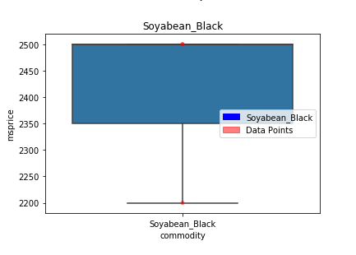
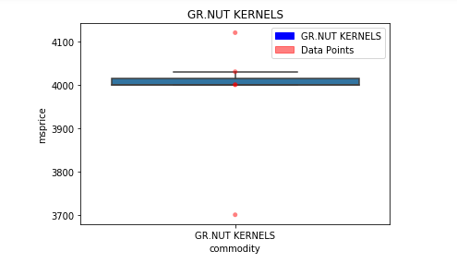
Kharif Crops
Outliers
Boxplot of Groundnut kernels represents MSP ranging above 4100 and below 3700 as outliers.
No outlier value in Soyabean black as all the MSP values lie within the normal range.

Slide 14
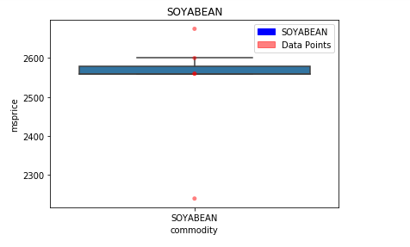
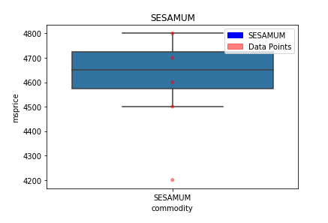
Kharif Crops
Outliers
Boxplot of Soyabean represents MSP ranging above 2600 and below 2300 as outliers.
Sesame represents MSP ranging below 4200 as outliers.

Slide 15
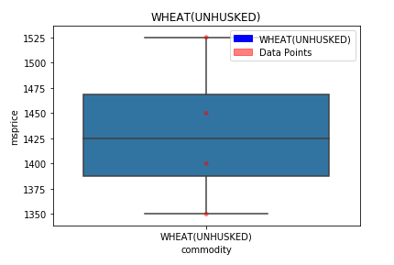
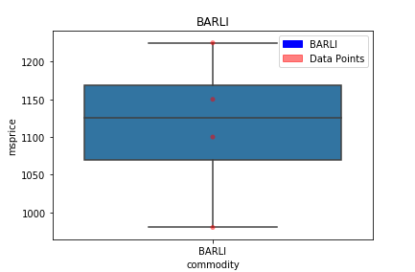
Rabi Crops
No outlier values are in Wheat(unhusked) and Barli as all the MSP values lie within the normal range.

Slide 16
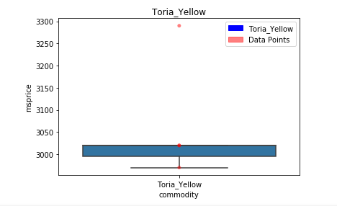
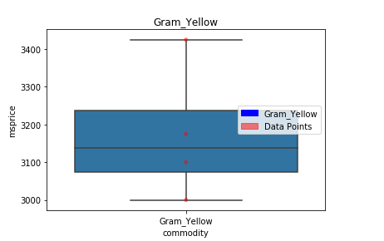
Rabi Crops
An outlier
Boxplot of Toria Yellow represents MSP ranging above 3250 as outliers.
No outlier value in Gram Yellow as all the MSP values lie within the normal range.

Slide 17
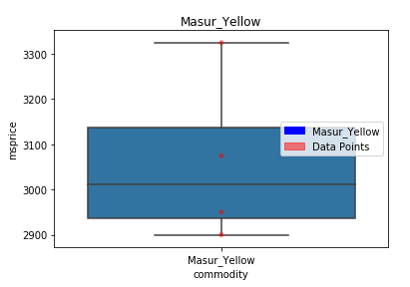
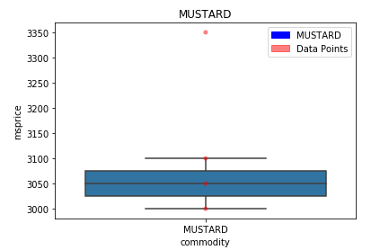
Rabi Crops
An outlier
Boxplot of Mustard represents MSP ranging above 3350 as outliers.
No outlier value in Masur Yellow as all the MSP values lie within the normal range.

Slide 18
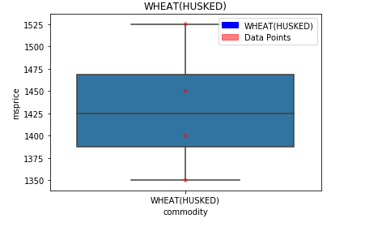
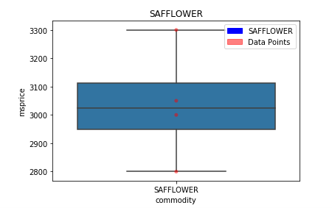
Rabi Crops
No outlier values are in Wheat(husked) and Safflower as all the MSP values lie within the normal range.

Slide 19
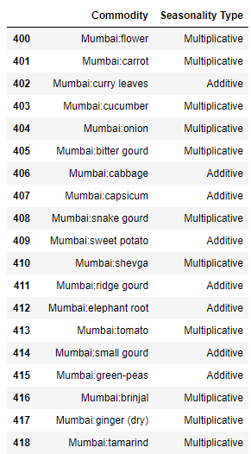
Identifying Seasonality Type

Slide 20
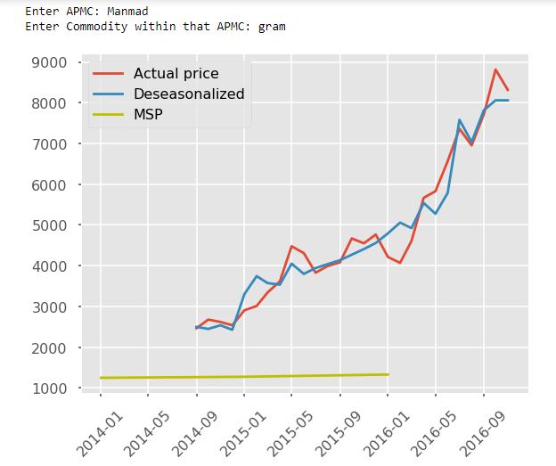
Comparing Raw Seasonalized and Deseasonalized Prices

Slide 21
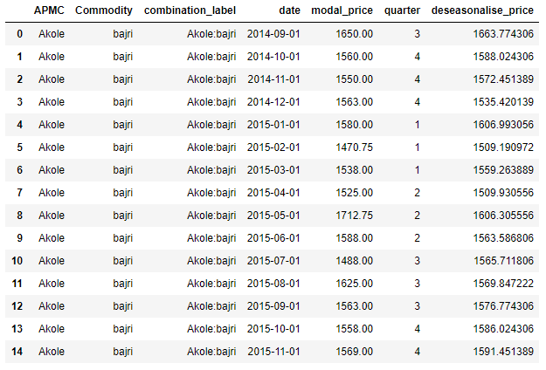
Calculating Deseasonalized Prices

Slide 22
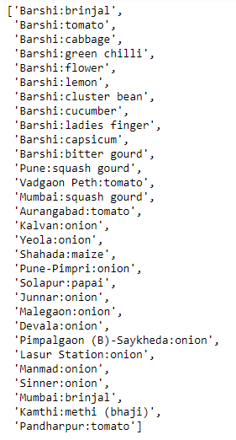
Top 30 Highest Price Fluctuating Commodities

Slide 23
Alternative Approach : For Transforming Time Series
Power Transformation- Effective way to stabilize Variances is to apply a power transformation (square root , cube root , log ) to the time series.
Subtracting Seasonal Means - One way to remove cycles in data observed periodically is to calculate the sample means of each of the periods then subtracting them from the corresponding period
Differencing - This method works very well in removing trends and cycles.

Slide 24
What else could have been done ?
Considering the drought situation in Maharashtra, I could have analyzed which crops with the lowest water retention and highest profitability across years could have been sown.
The factors which I could have additionally taken into account
Inflation
Current Area under cultivation
Water Retention
Harvesting Period

Slide 25
Tools Used
Statsmodel (For calculating de-seasonalized price)
Scipy Package
Numpy , Pandas , Matplotlib

Slide 26
Conclusions
Price Fluctuations
The agricultural commodities with highest price fluctuations are Brinjal, Tomato and Cabbage in Barshi cluster.
The agricultural commodity with medium price fluctuation is squash Gourd in Mumbai.
The agricultural commodity with lowest price fluctuation is Tomato in Pandharpur cluster.
MSP Prices
Copra(Ball) has highest MSP in 2016 with a value of 6240.
Masur yellow has medium MSP in 2015 with a value of 3325.
Sugarcane has lowest MSP in 2012 with a value of 170.

Slide 27
Conclusions
Compensation by Govt measured as a difference between modal price and MSP
Maximum compensation was given to Sesame crop in 2016 with a difference of 5850.
Minimum compensation was given to Maize crop in 2015 with a difference of 475.
Seasonality
Commodities within clusters suffers more with multiplicative seasonality type in comparison to additive seasonality.
Difference between Raw Prices(Modal price) and Deseasonalized Prices
Cardamom has maximum difference between raw price and deseasonalized Price in year 2016 with a value of 44792.76
Cashewnuts has minimum difference between raw price and deseasonalized Price in year 2016 with a value of -21349.14.

